Slide 1
W241 Final Project
Marcus Streips | Jason Papale | Collin Cunningham

Slide 2
Problem Background
Technical hiring is often about finding candidates who have experience with specific tools
Applicant Tracking Systems often scan candidates resumes and applications for keywords
Blogs and websites allege that these systems can be beaten or tricked into passing candidates along to human reviewers
Research Question
Does adding invisible job-relevant keywords at the bottom of your resume increase chances of being interviewed?

Slide 3
Study Design
Create fictional applicant that is seeking employment in data analysis
Design two iterations of the resume:
One that lists experience while avoiding specific keywords
One that is identical to the first but with hundreds of data analysis keywords in white font at the bottom
Build identical ZipRecruiter accounts for each applicant
Sequentially go through relevant job listings, flip a coin and apply to that job with the corresponding account
Give employers two weeks to respond

Slide 4
Results
Pilot Study
Applying on company website: 10 applications, 1 response
ZipRecruiter test: 1 application, 1 response
Full Study
Applied to 252 job listings in 4 cities
Received 2 responses: one from an MLM company (thrown out) and one true interview
Unable to perform meaningful analysis with one response

Slide 5
What went wrong?
Pilot Study
During the pilot study we applied directly to companies
Tested ZipRecruiter with one application which turned out to be promoted and lead us to an MLM
COVID 19
15% of job postings were closed within the first week we started applying
Many companies froze hiring or began to lay people off

Slide 6
What went wrong? (continued)
Study Design
Application Tracking System (ATS)
Used by 98% of Fortune 500 Corps and 40% of all US employers.
Automatically reject 75% of applicants
Market dominated by top 6 players
Need to understand how ATS affect treatment
Conducted patent and literature search to understand process
General Theme: résumé is parsed, labeled and scored
Scoring algorithms have been trained to recognize “keyword stuffing”
Restricted qualified job postings to one solution (ZipRecruiter)
Notes:
[Marcus]

Slide 7
Pivot to Alternate Experiment
Due to inability to successfully complete first experiment, we pivoted towards another experiment (Conor and Andrew’s experiment).
Seeks to understand how hikers and backpackers decide to take water along their hikes.
We simplified the experiment due to
~2 week turnaround period.
Desire to be able to generalize results outside of hiking context.
Research Question
To what degree does providing a probability (as opposed to a general statement) regarding the availability of a critical resource (e.g. water) affect its perceived necessity.
Notes:
[Marcus]

Slide 8
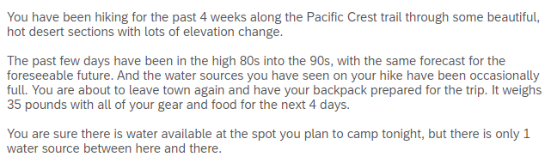
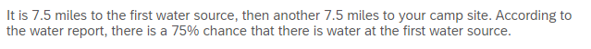
Study Design
Default Question Block
Age
Gender
Height
Weight
Marital Status
Parental Status
Education
Level of Physical Activity
Hiking Experience (general)
Hiking Experience (desert)
Prior Existing Conditions
Scenario
Control (“Usually”)
Treatment (“75% Chance”)
Notes:
[Marcus]

Slide 9
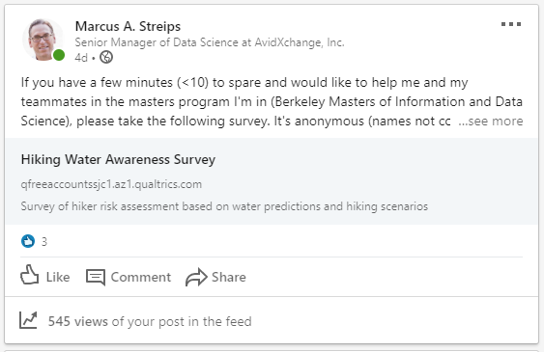
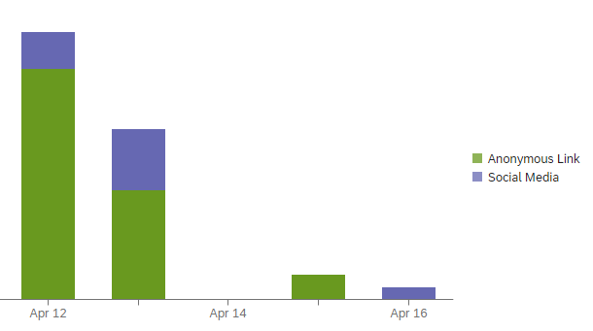
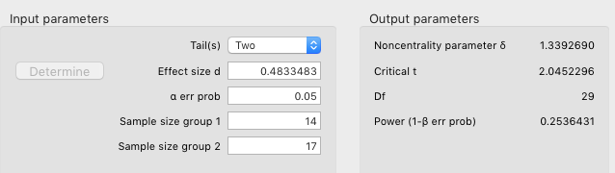
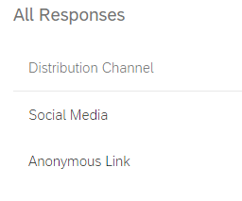
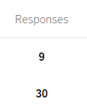
Survey Distribution and Response
Restricted qualified job postings to one solution
Notes:
[Marcus]

Slide 10
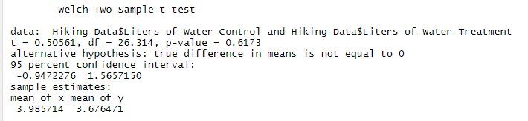
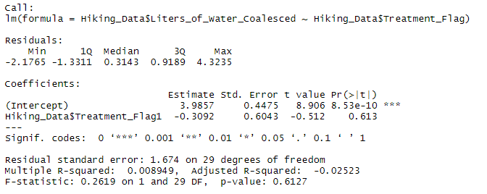
Results
T-Test
Simple Linear Regression

Slide 11
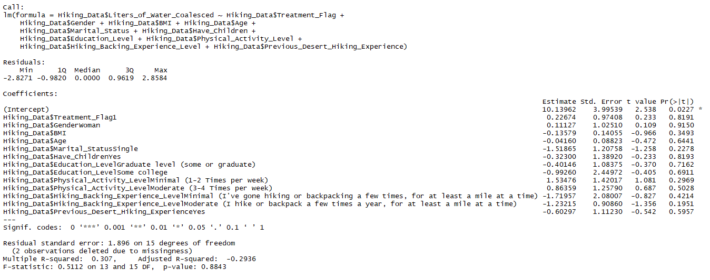
Results (Continued)
Multiple Regression

Slide 12
Findings
Average treatment effect of -.31 liters is not significant with a p-value of .613; however, the experiment is likely underpowered due to sample size and detecting a significant effect is unlikely.
Results from multiple regression should be interpreted with caution due to low sample size across a relatively wide number of covariates.
Careful interpretation is required:
Based on the results, we fail to reject the null hypothesis that providing a probability regarding the availability of critical resources has an effect on the perceived necessity of those resources.
However, it is crucial to recognize that this finding is only applicable when the specific information is a 75% probability.
Additional experimentation would be required to understand if this finding changes as the probability of having critical resources be available increases or decreases.
Similarly, the findings of this experiment would support the hypothesis that, in this context, individuals may consider a 75% probability to be comparable to “usually.”

Slide 13
Questions

Slide 14
Appendix

Slide 15
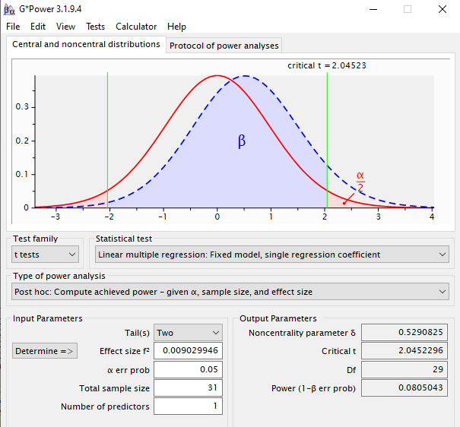
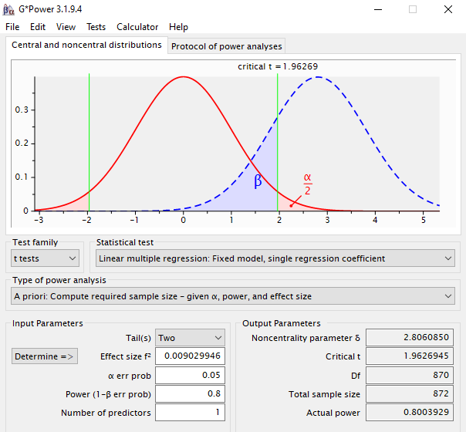
Power Calculations (Based on Results of Alternate Experiment)
Post Hoc
A priori

Slide 16
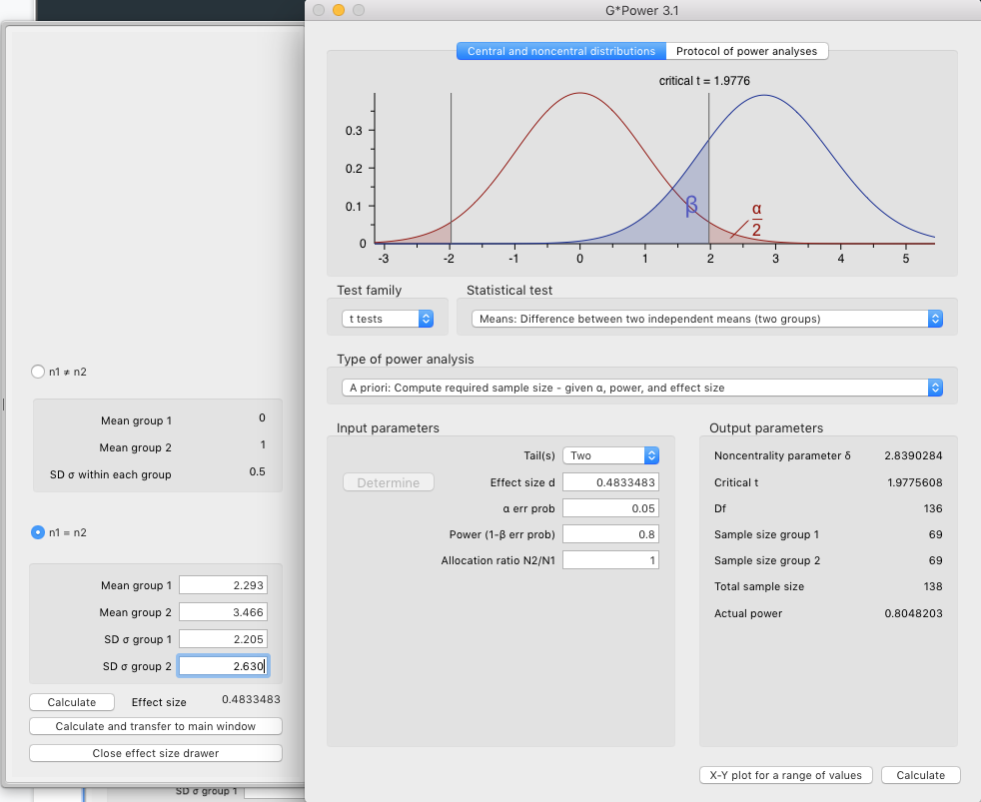
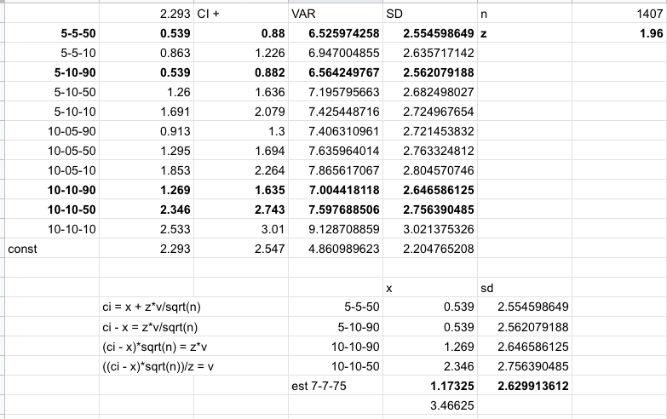
Study Design
Estimating Sample Size From Prior Study Data
Effect Size: 0.4833
Power: 0.8048
Sample Size: 136
Notes:
[Marcus] prior experiment control was 5 - 5 - 90 vs 7 - 7 - 75

